Slide 1
A Narrow Linewidth Laser for Atomic Physics
Chung You Shih
Advisor: Dr. Ming-Shien Chang

Slide 2
Outline
Introduction
Design
Measurement
Frequency locking
Conclusion & Future Work

Slide 3
Introduction to ECDL
L
What is ?
E
C
D
xternal
avity
iode
aser

Slide 4
Diode Laser for Atomic Physics
Pros
Cons
high efficiency
compact
inexpensive
wider linewidth
almost maintenance-free
Very stable

Slide 5
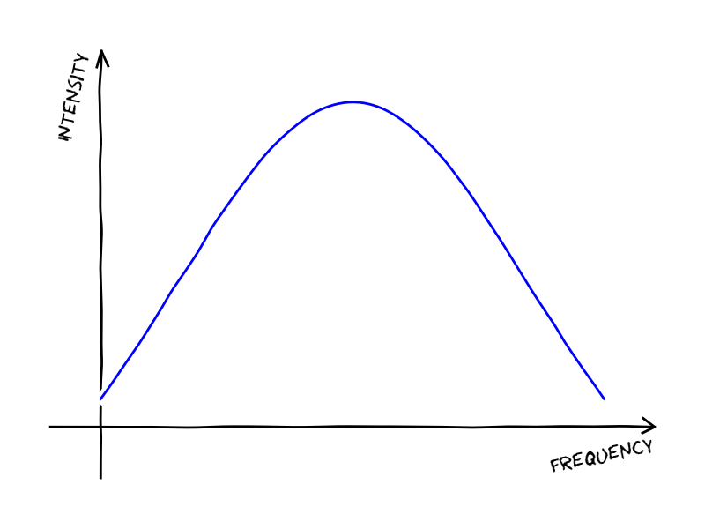
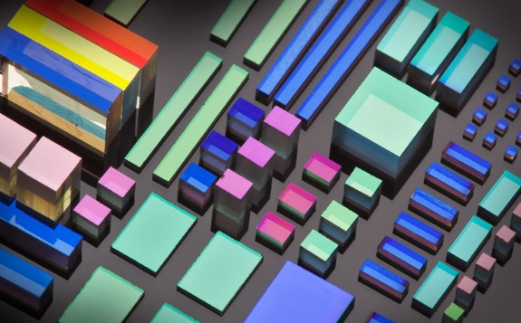
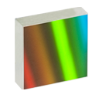
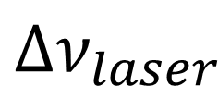


External Cavity
select central frequency
Surface Grating
Volume Holography Grating
Color Filter
$$Δν_{laser}$$
Narrow laser linewidth
Schawlow-Townes Linewidth:
$$Δν_{laser}=\frac{hν\left(1+α^{2}\right)l_{tot}T_{oc}}{4πT_{rt}^{2}P_{out}}$$
$$ν$$

Slide 6
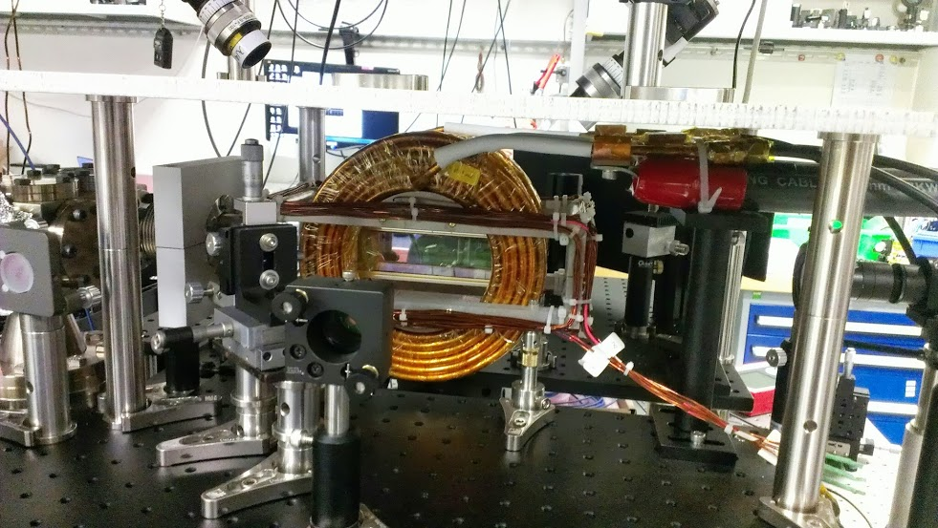
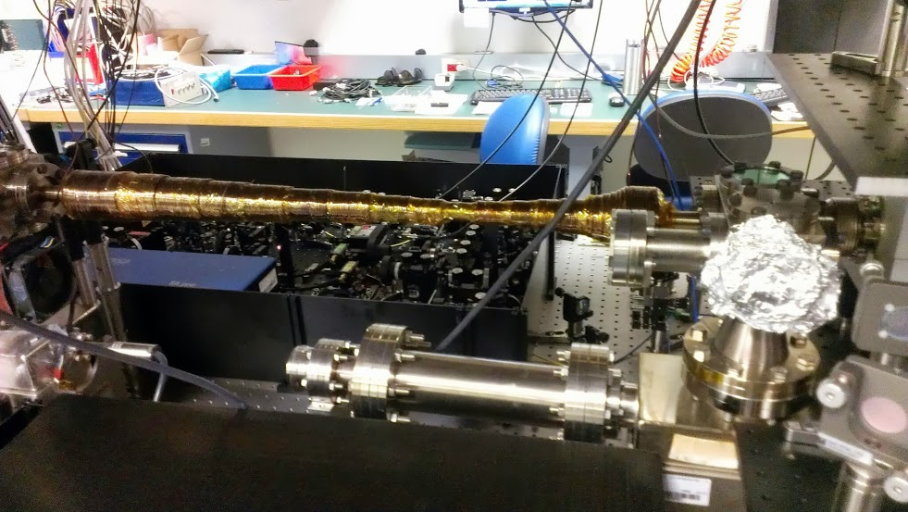
Purpose – Cold Atom Physics
Probe atoms
laser cooling
Coherent control on atomic states
optical trap (detuned)

Slide 7
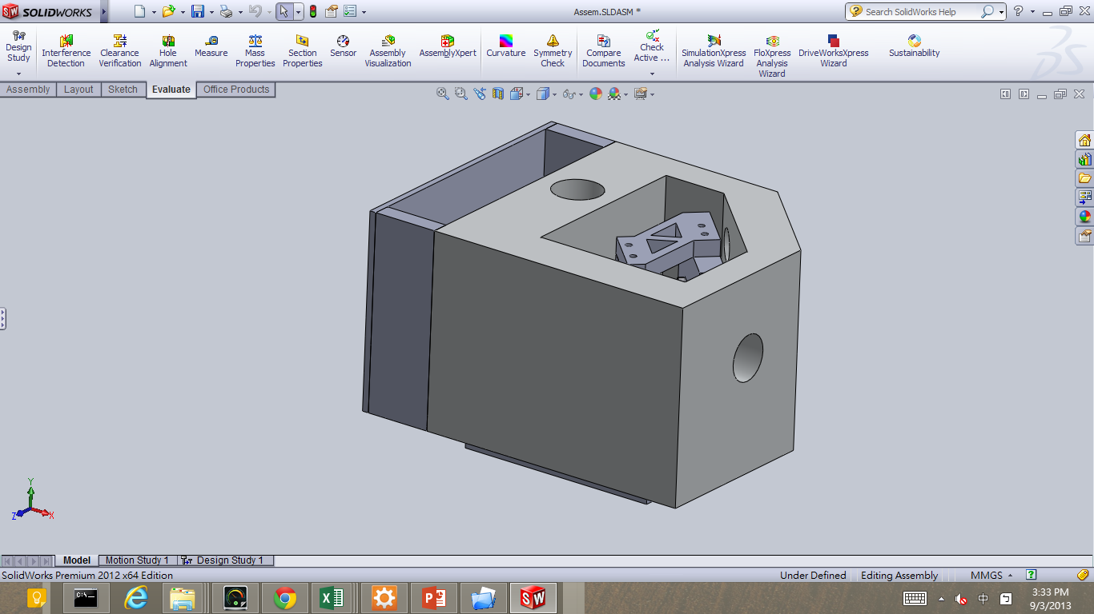
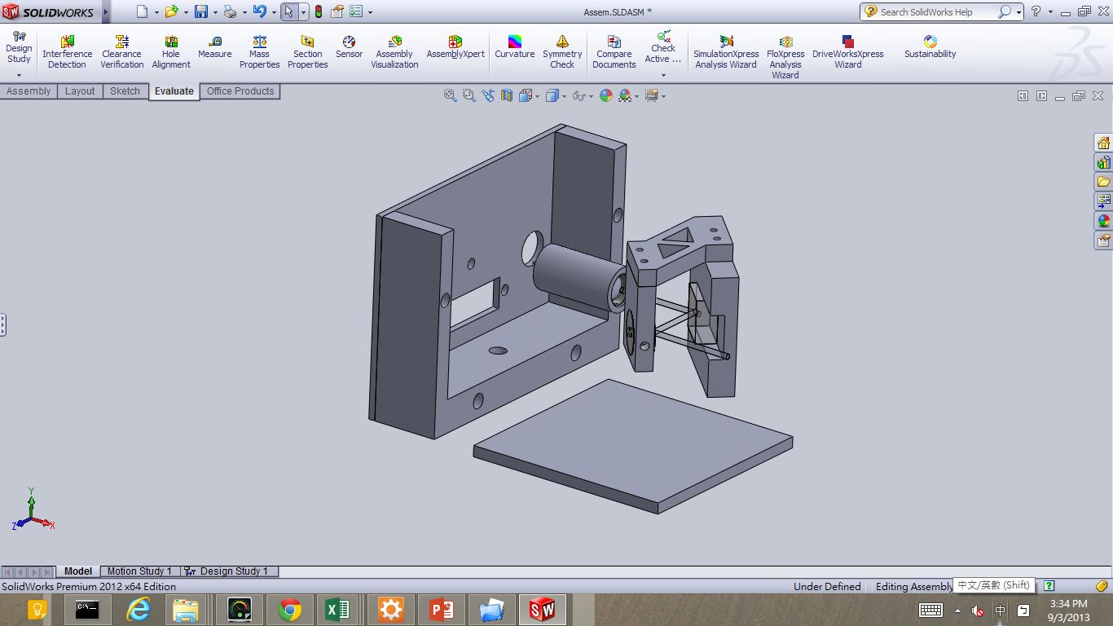
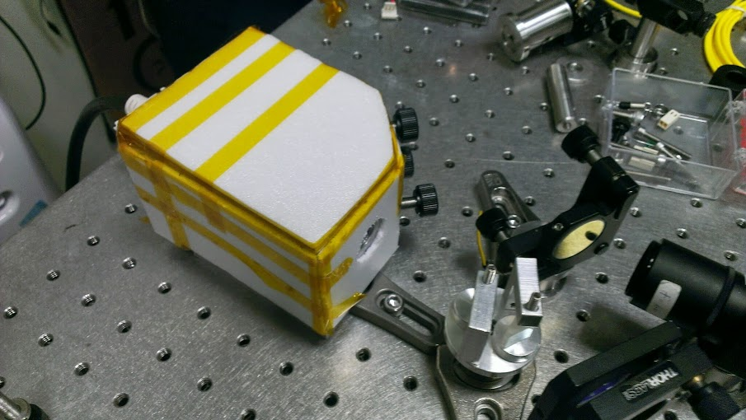
Idea: Monolithic cavity design
1.high heat capacity
2.good heat conductivity
temperature control
Mechanical Stability

Slide 8
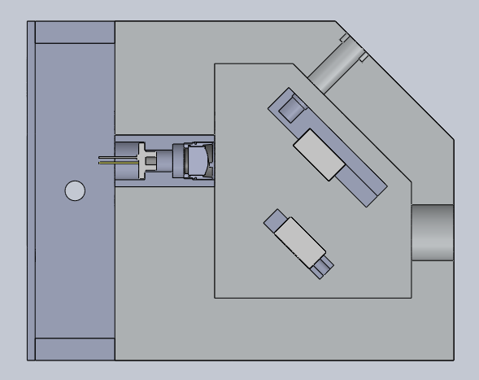
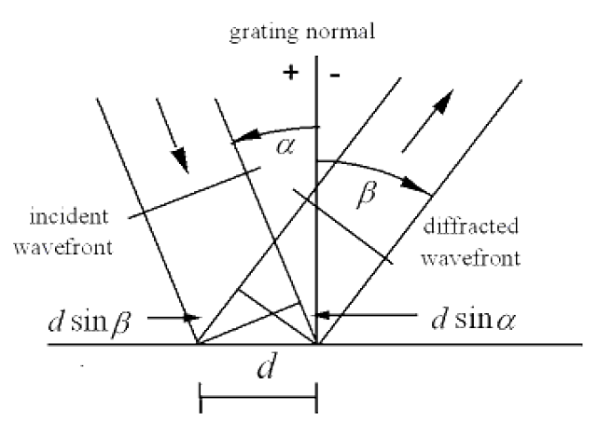
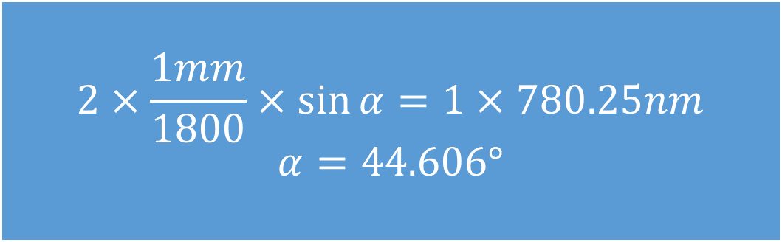



Littrow configuration
The grating is always parallel to the mirror.
No angle shift
Δ𝑥=2𝑙Δ𝜃
Grating equation:
$d(\sin{α}+\sin{β)=mλ}$
m=1
optical feed back
m=1, $α=β$ for optical feed back
$2d\sin{α}=λ$
$$2×\frac{1mm}{1800}×\sin{α}=1×780.25nm$$
$$α=44.606°$$
m=0 for beam output
$α=−β$ (law of reflection)
m=0
beam output

Slide 9
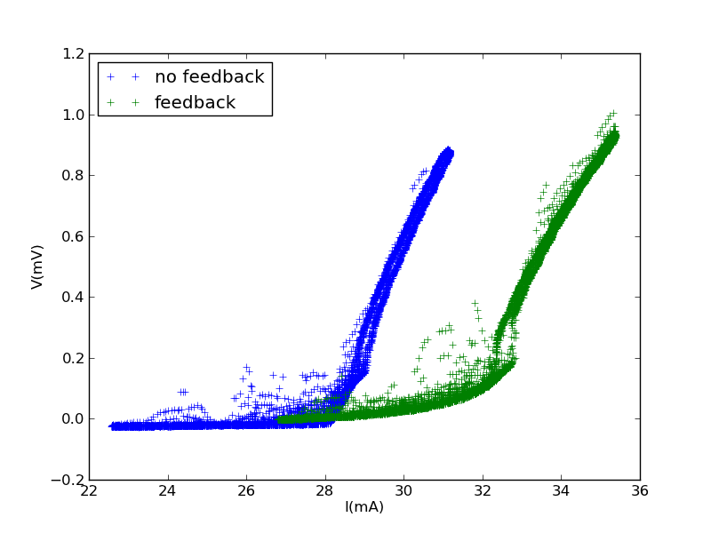
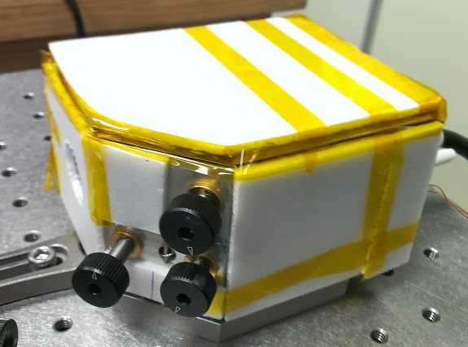
Threshold Current

Slide 10
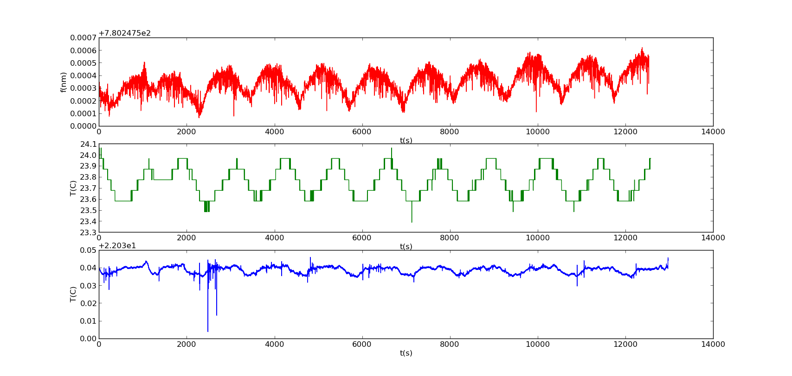
Free running
the same period
<10mk

Slide 11
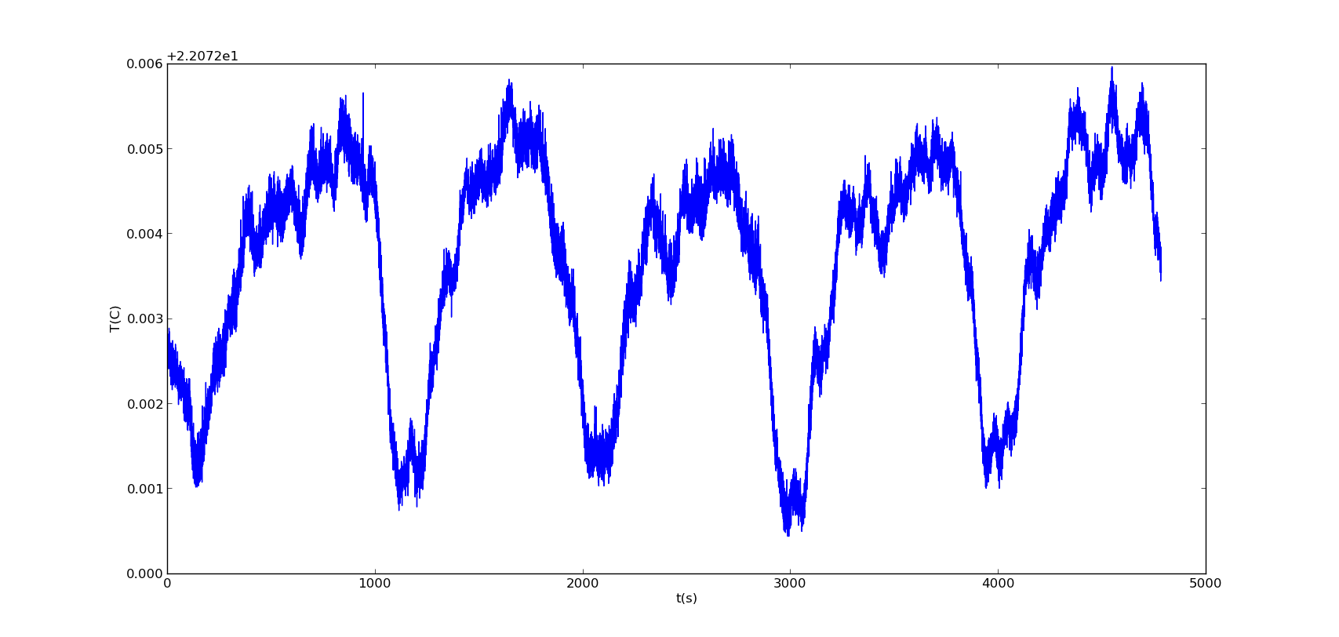
<5mk

Slide 12


Lock-in-Amplifier
PID
PD
250kHz
ECDL
optical isolator
PBS
$λ$/2
wave meter
coil
vapor cell
$λ$/4

Slide 13
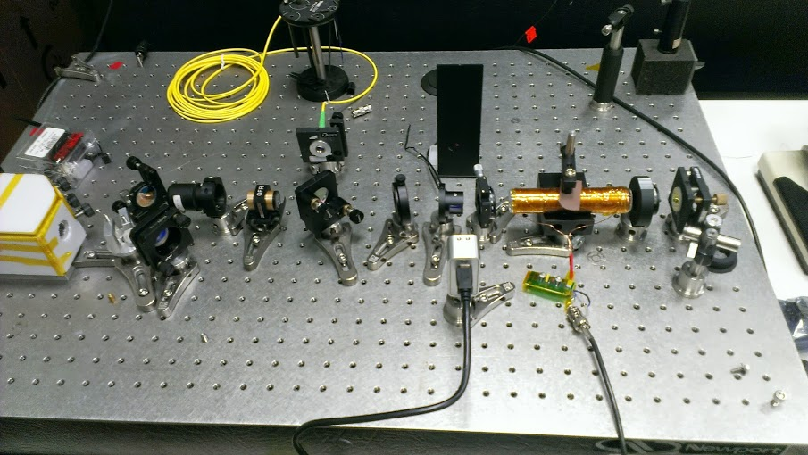

Slide 14
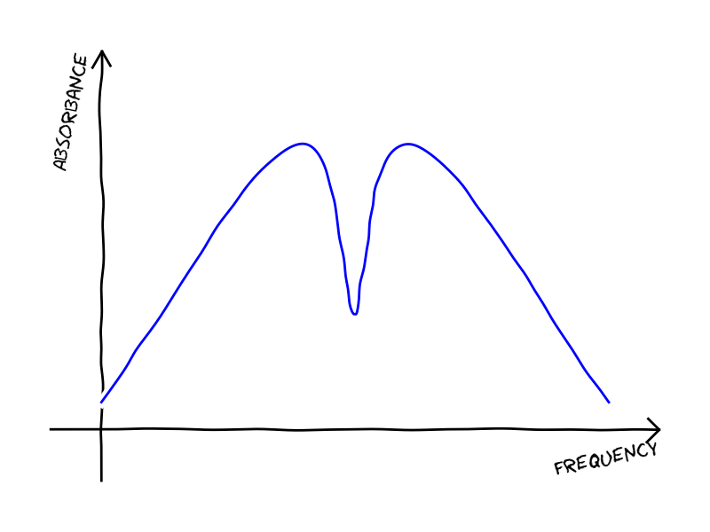
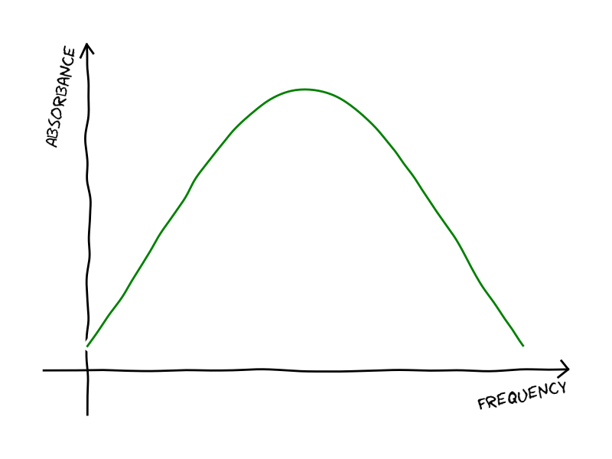
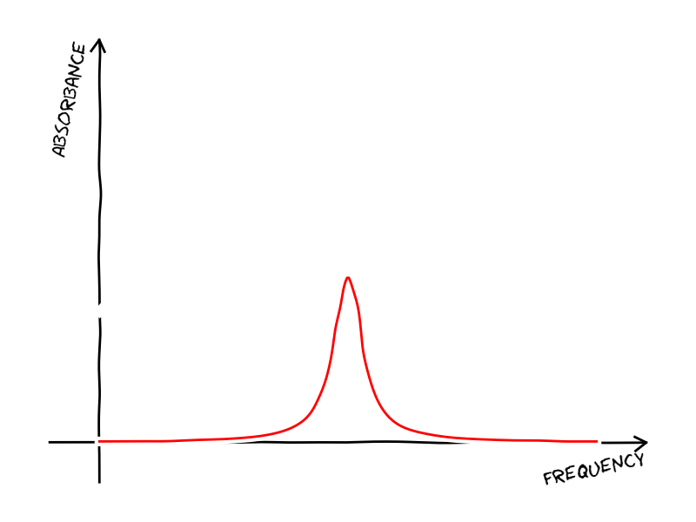
v_{z}=0
Negative
Positive
Nature
(Lorentzian)
Doppler Borden
(Gaussian)
vapor cell

Slide 15
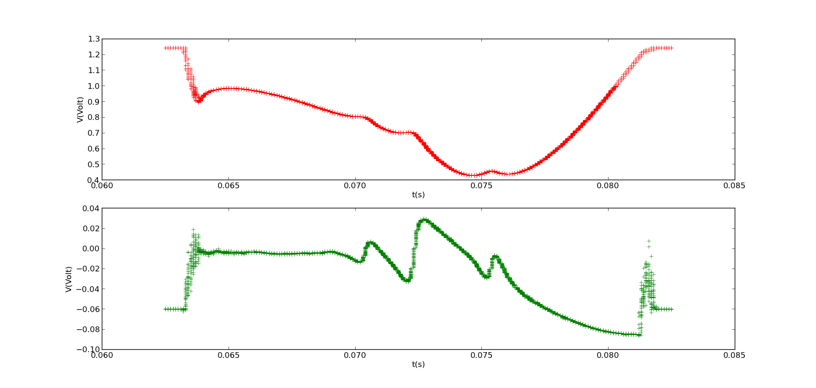
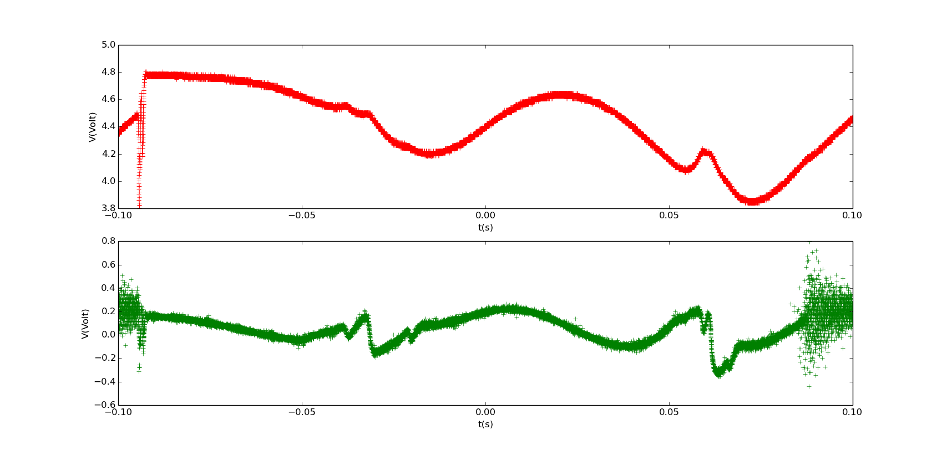
Rb-87 D2 Line

Slide 16
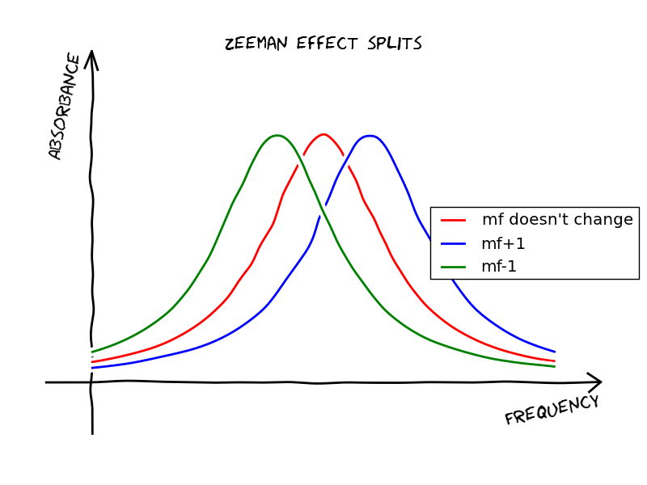
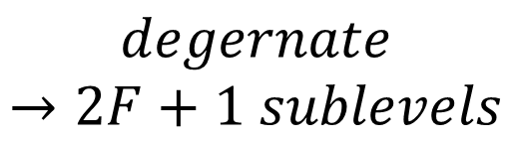
vapor cell
Linear
Circular
$$degenerate$$
$$→2F+1 sublevels$$
$λ$/4

Slide 17

$frequency:ν=ν_{L}+ν_{m}\cos{ωt}$
$V\left(ν_{L}+ν_{m}\cos{ωt}\right)≈V\left(ν_{L}\right)+{\left(\frac{∂V}{∂ν}\right)}_{ν_{L}}ν_{m}\cos{ωt}$
Lock-in Amplifier: Multiplier + Low Pass Filter
$\int{\left(V\left(ν_{L}\right)+{\left(\frac{∂V}{∂ν}\right)}_{ν_{L}}ν_{m}\cos{ωt}\right)×K\cos{ωt }dt=\frac{K}{2}{\left(\frac{∂V}{∂ν}\right)}_{ν_{L}}ν_{m}}$
Lock-in-Amplifier
PID
250kHz
vapor cell

Slide 18
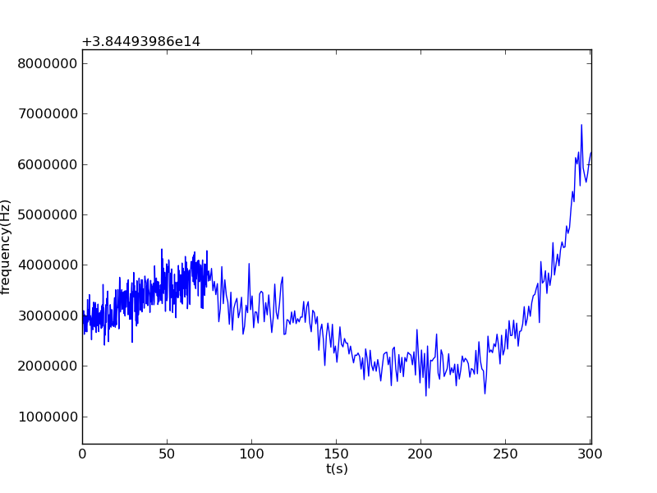
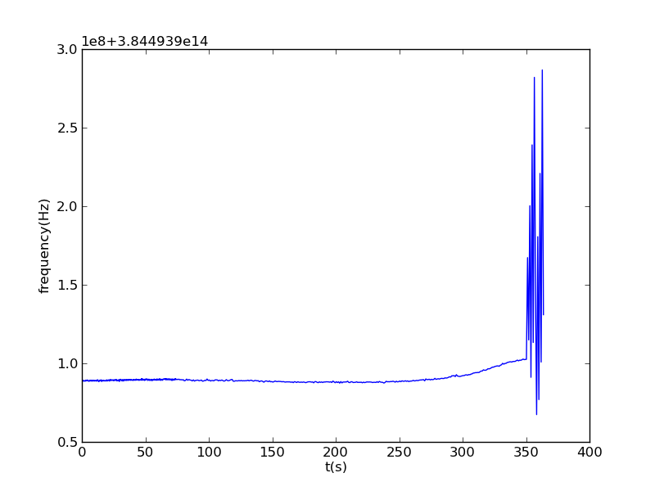
<3MHz

Slide 19
Conclusion
Monolithic cavity design
Laser stability study
Saturation spectroscopy
Laser frequency stabilization

Slide 20
Future Work
Linewidth measurement
Frequency locking optimization
Laser cooling

Slide 21

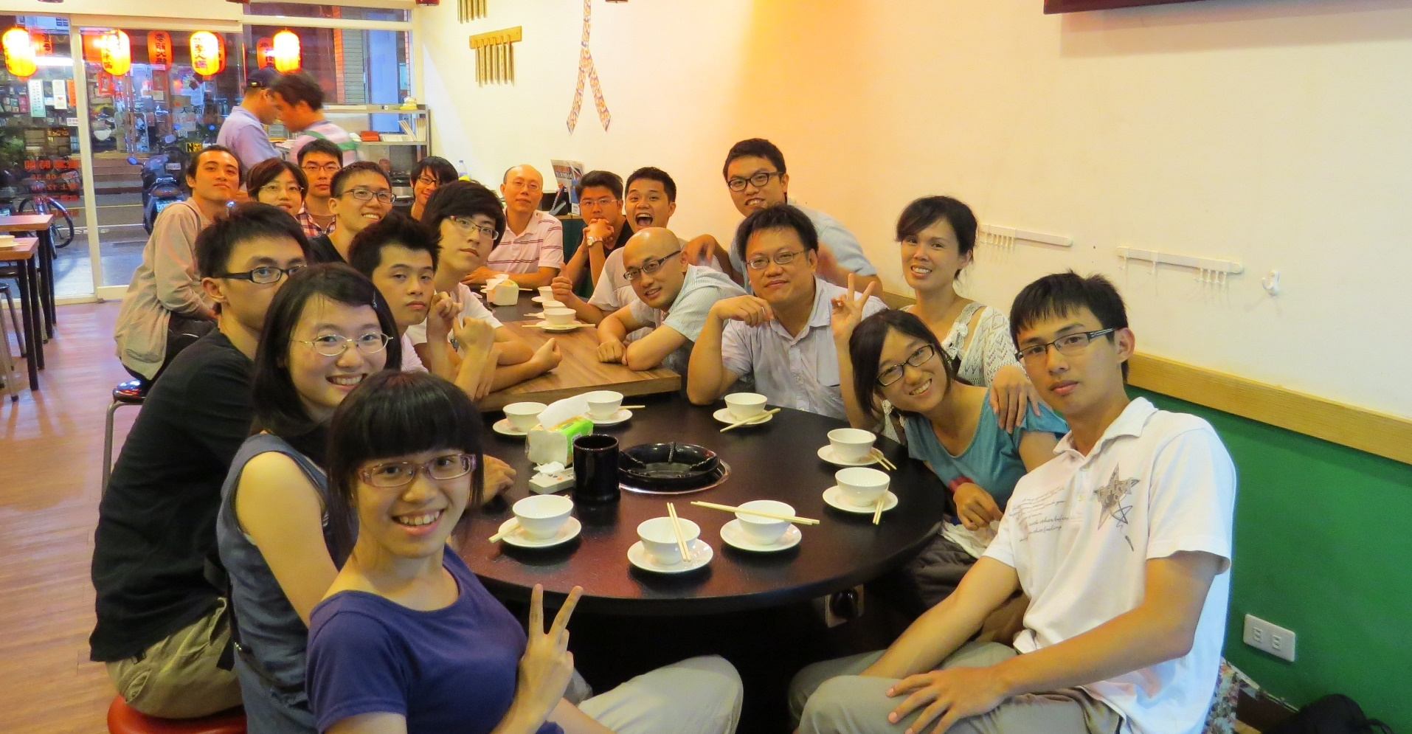
Acknowledgement
Lab 107 &
Dr. Ming-Shien Chang

Slide 22
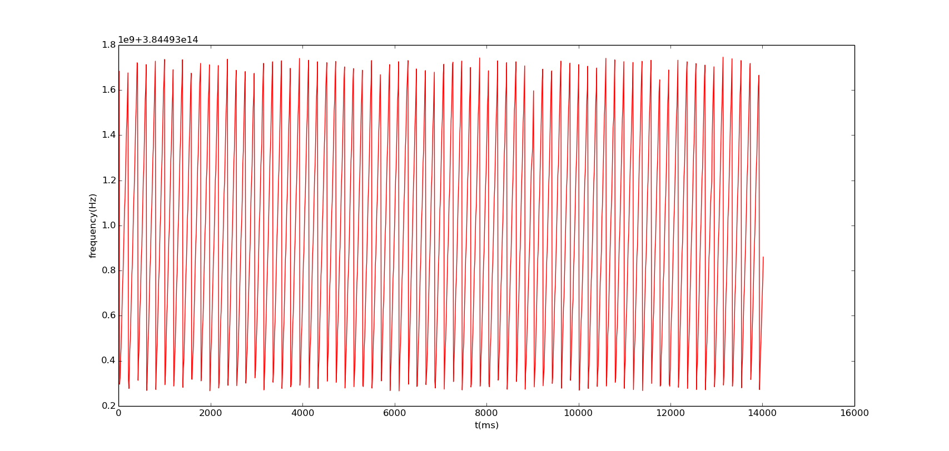

Mode-Hop-Free Tuning Range $≈$ 1.7GHz

